Slide 1
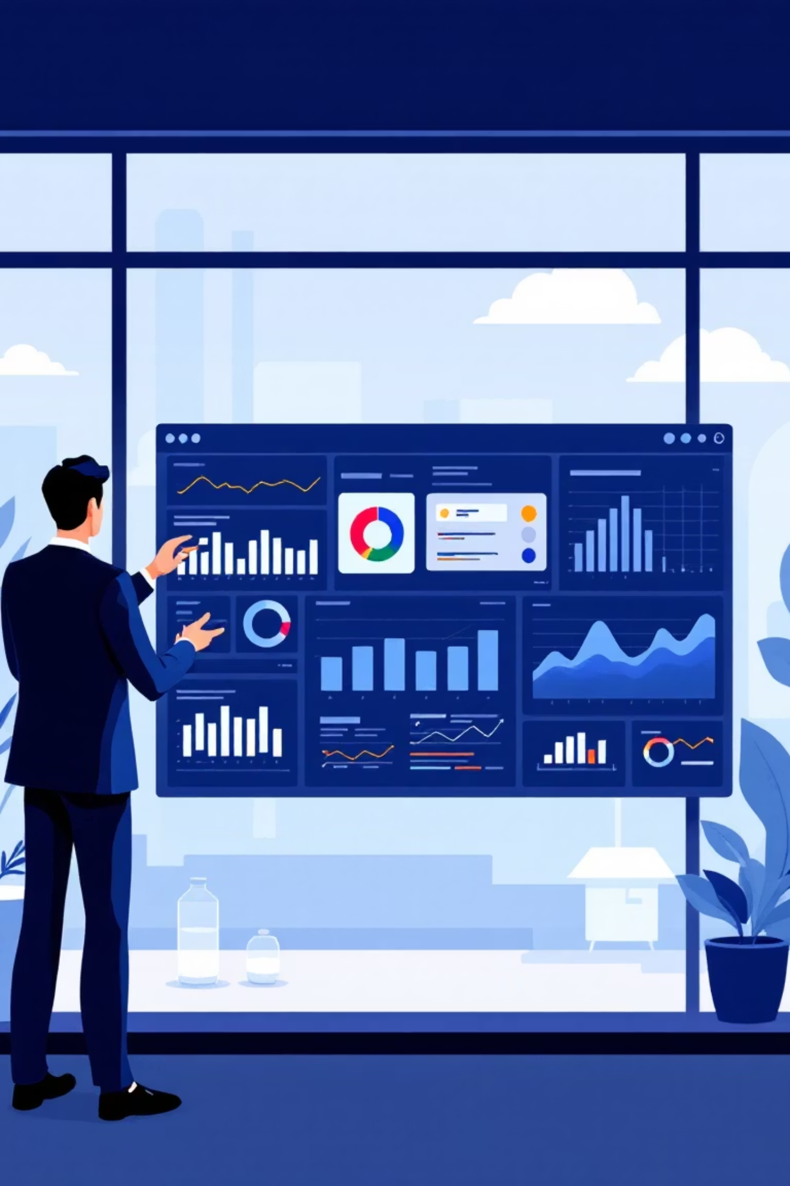
Marketing & Campaign Effectiveness Analysis
Unlocking strategic insights to optimize campaign performance and maximize ROI through data-driven customer segmentation.

Slide 2


Revenue Is Highly Concentrated
70%
25%
5%
High-Value Share
Mid-Value Share
Low-Value Share
High-value customers contribute the majority of total revenue
Largest customer base but lower revenue per customer
Minimal contribution to overall revenue
Key Takeaway: Revenue stability depends heavily on retaining high-value customers.

Slide 3
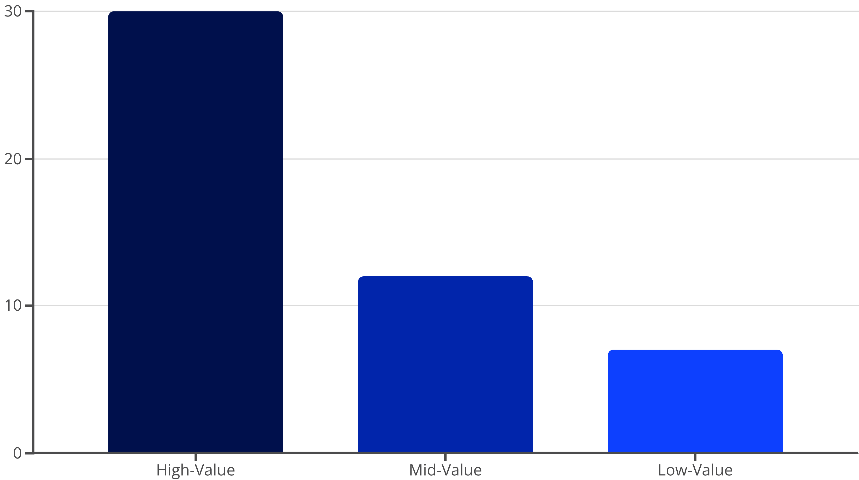

Campaign Response Varies by Segment
High-value customers show the highest campaign response rate at ~30%, while mid-value customers respond at ~12% and low-value customers at just ~7%.
Key Takeaway: Broad campaigns dilute effectiveness and reduce ROI.

Slide 4

Responders Drive Higher Value
Campaign Responders
Non-Responders
Spend significantly more per customer
Lower customer value
Reduced purchase activity
Higher purchase frequency
Minimal engagement levels
Greater overall engagement
Key Takeaway: Campaigns attract high-value behavior, not low-value noise.

Slide 5


Timing Matters: Recency Drives Response
Recent Purchase
Long Inactivity
High response rates from customers with recent activity
Minimal response from dormant customers
1
2
3
Moderate Gap
Declining engagement as time passes
Key Takeaway: Timing campaigns around recent purchases improves response rates.

Slide 6

Growth Opportunity & ROI Challenges
Mid-Value: Largest Growth Opportunity
Largest customer segment with strong upsell potential. Response rate and spend indicate readiness to move into high-value tier.
Low-Value: Poor Marketing ROI
Minimal revenue contribution and weak response rates. High marketing spend yields limited returns on this segment.
Strategic Implication: Focus resources on mid-value customers while excluding low-value segments from high-cost campaigns.

Slide 7
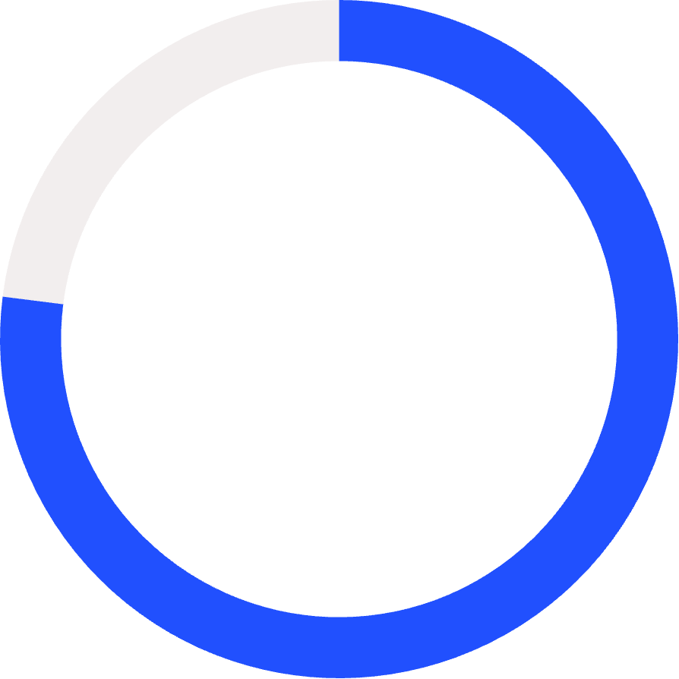
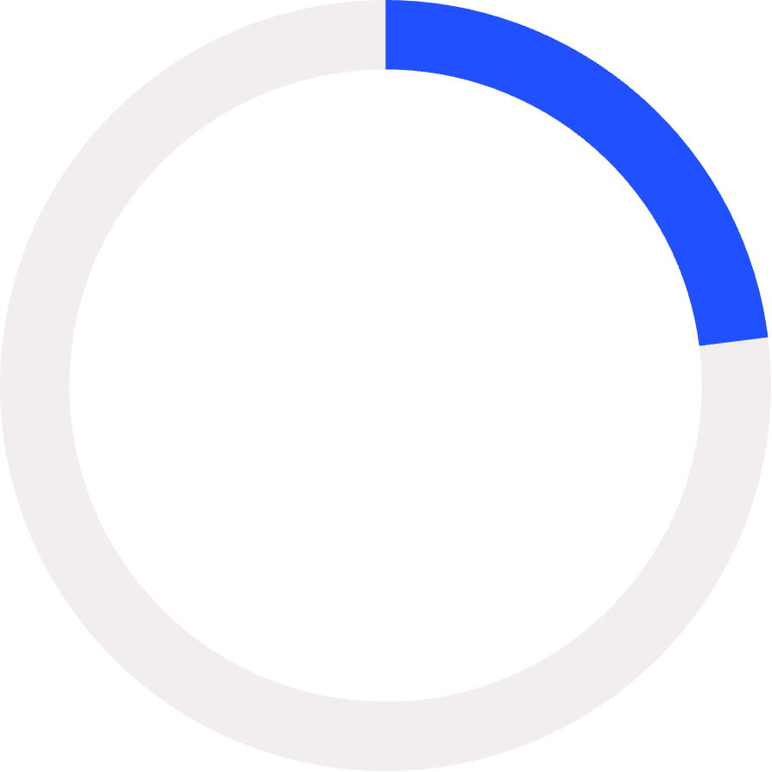
Product Category Performance
77%
23%
Wine & Meat
Other Categories
Combined revenue from top categories
All remaining product lines
Key Takeaway: Campaigns should focus on high-revenue product categories like Wine and Meat.

Slide 8
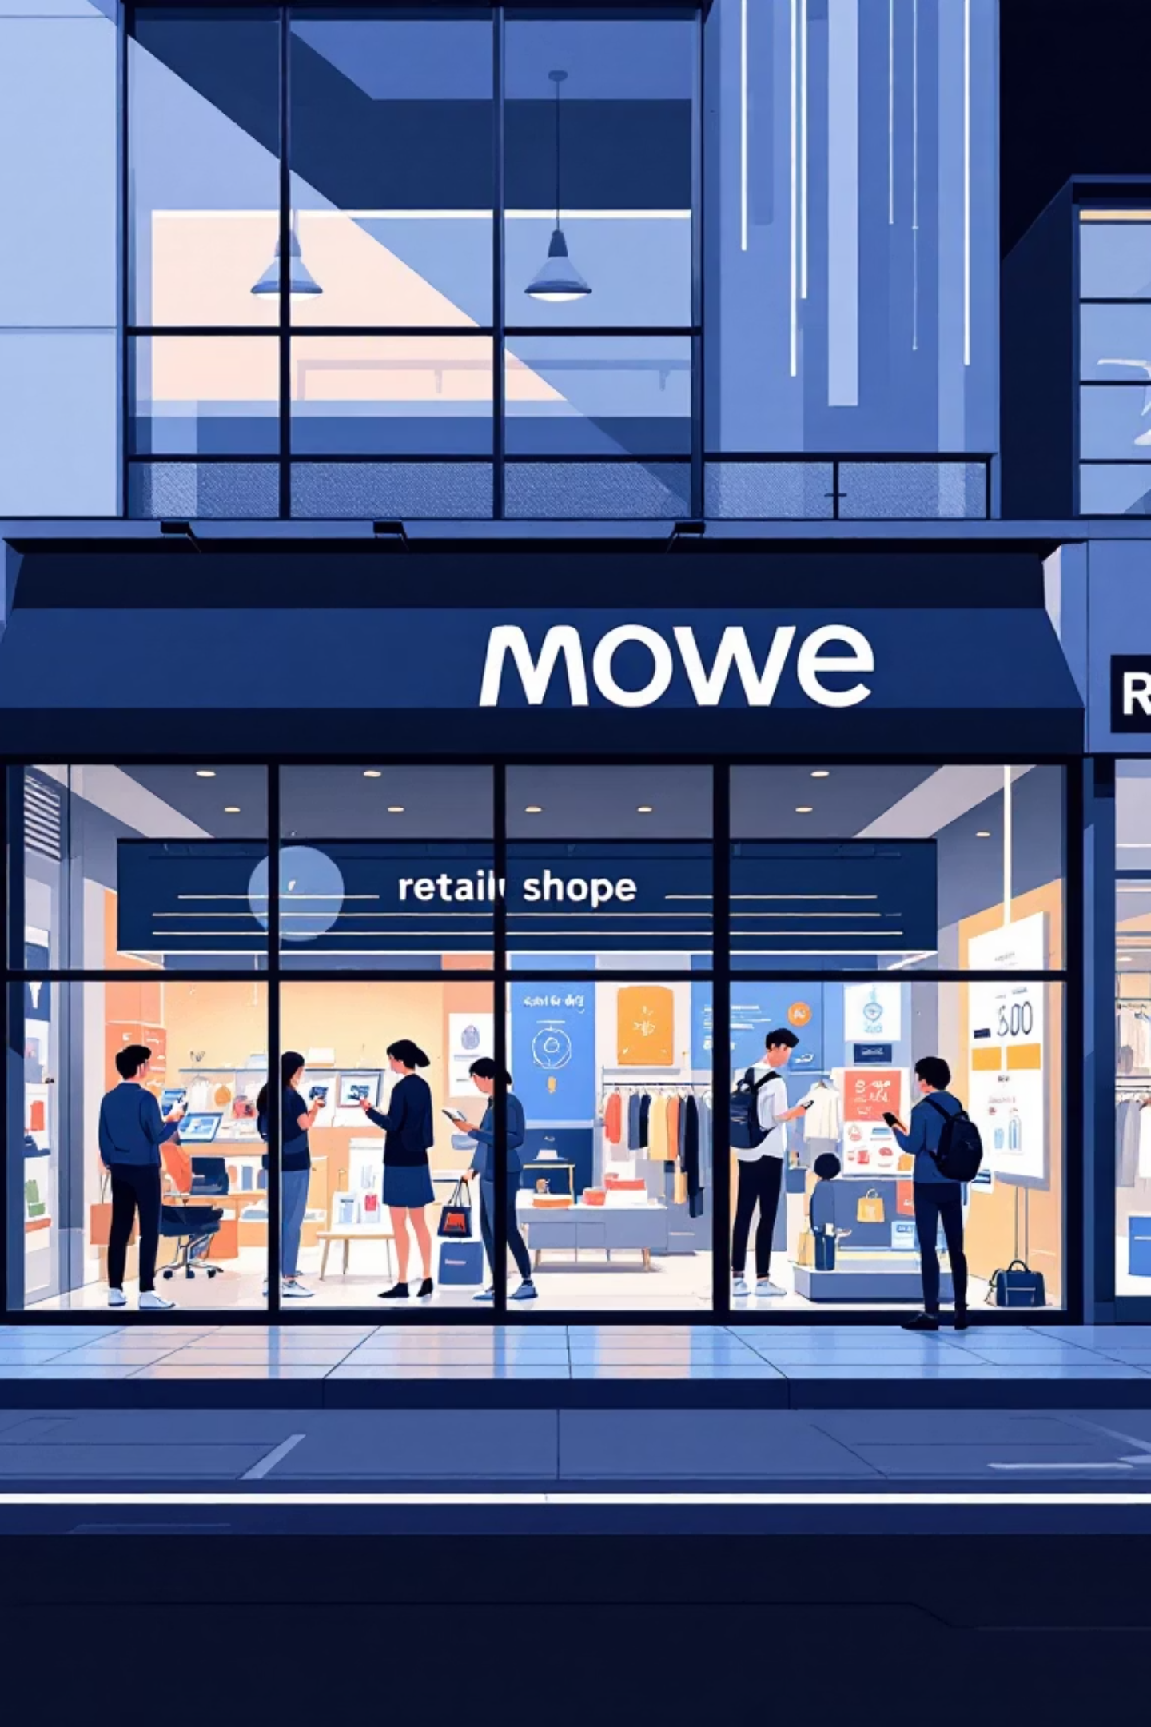


Customer Purchase Channel Preferences
Store Purchases
Web Channel
Dominant channel for customer transactions
Strong secondary channel with growing importance
Catalog
Limited usage compared to other channels
Key Takeaway: Campaigns should be store-led with strong digital support.

Slide 9
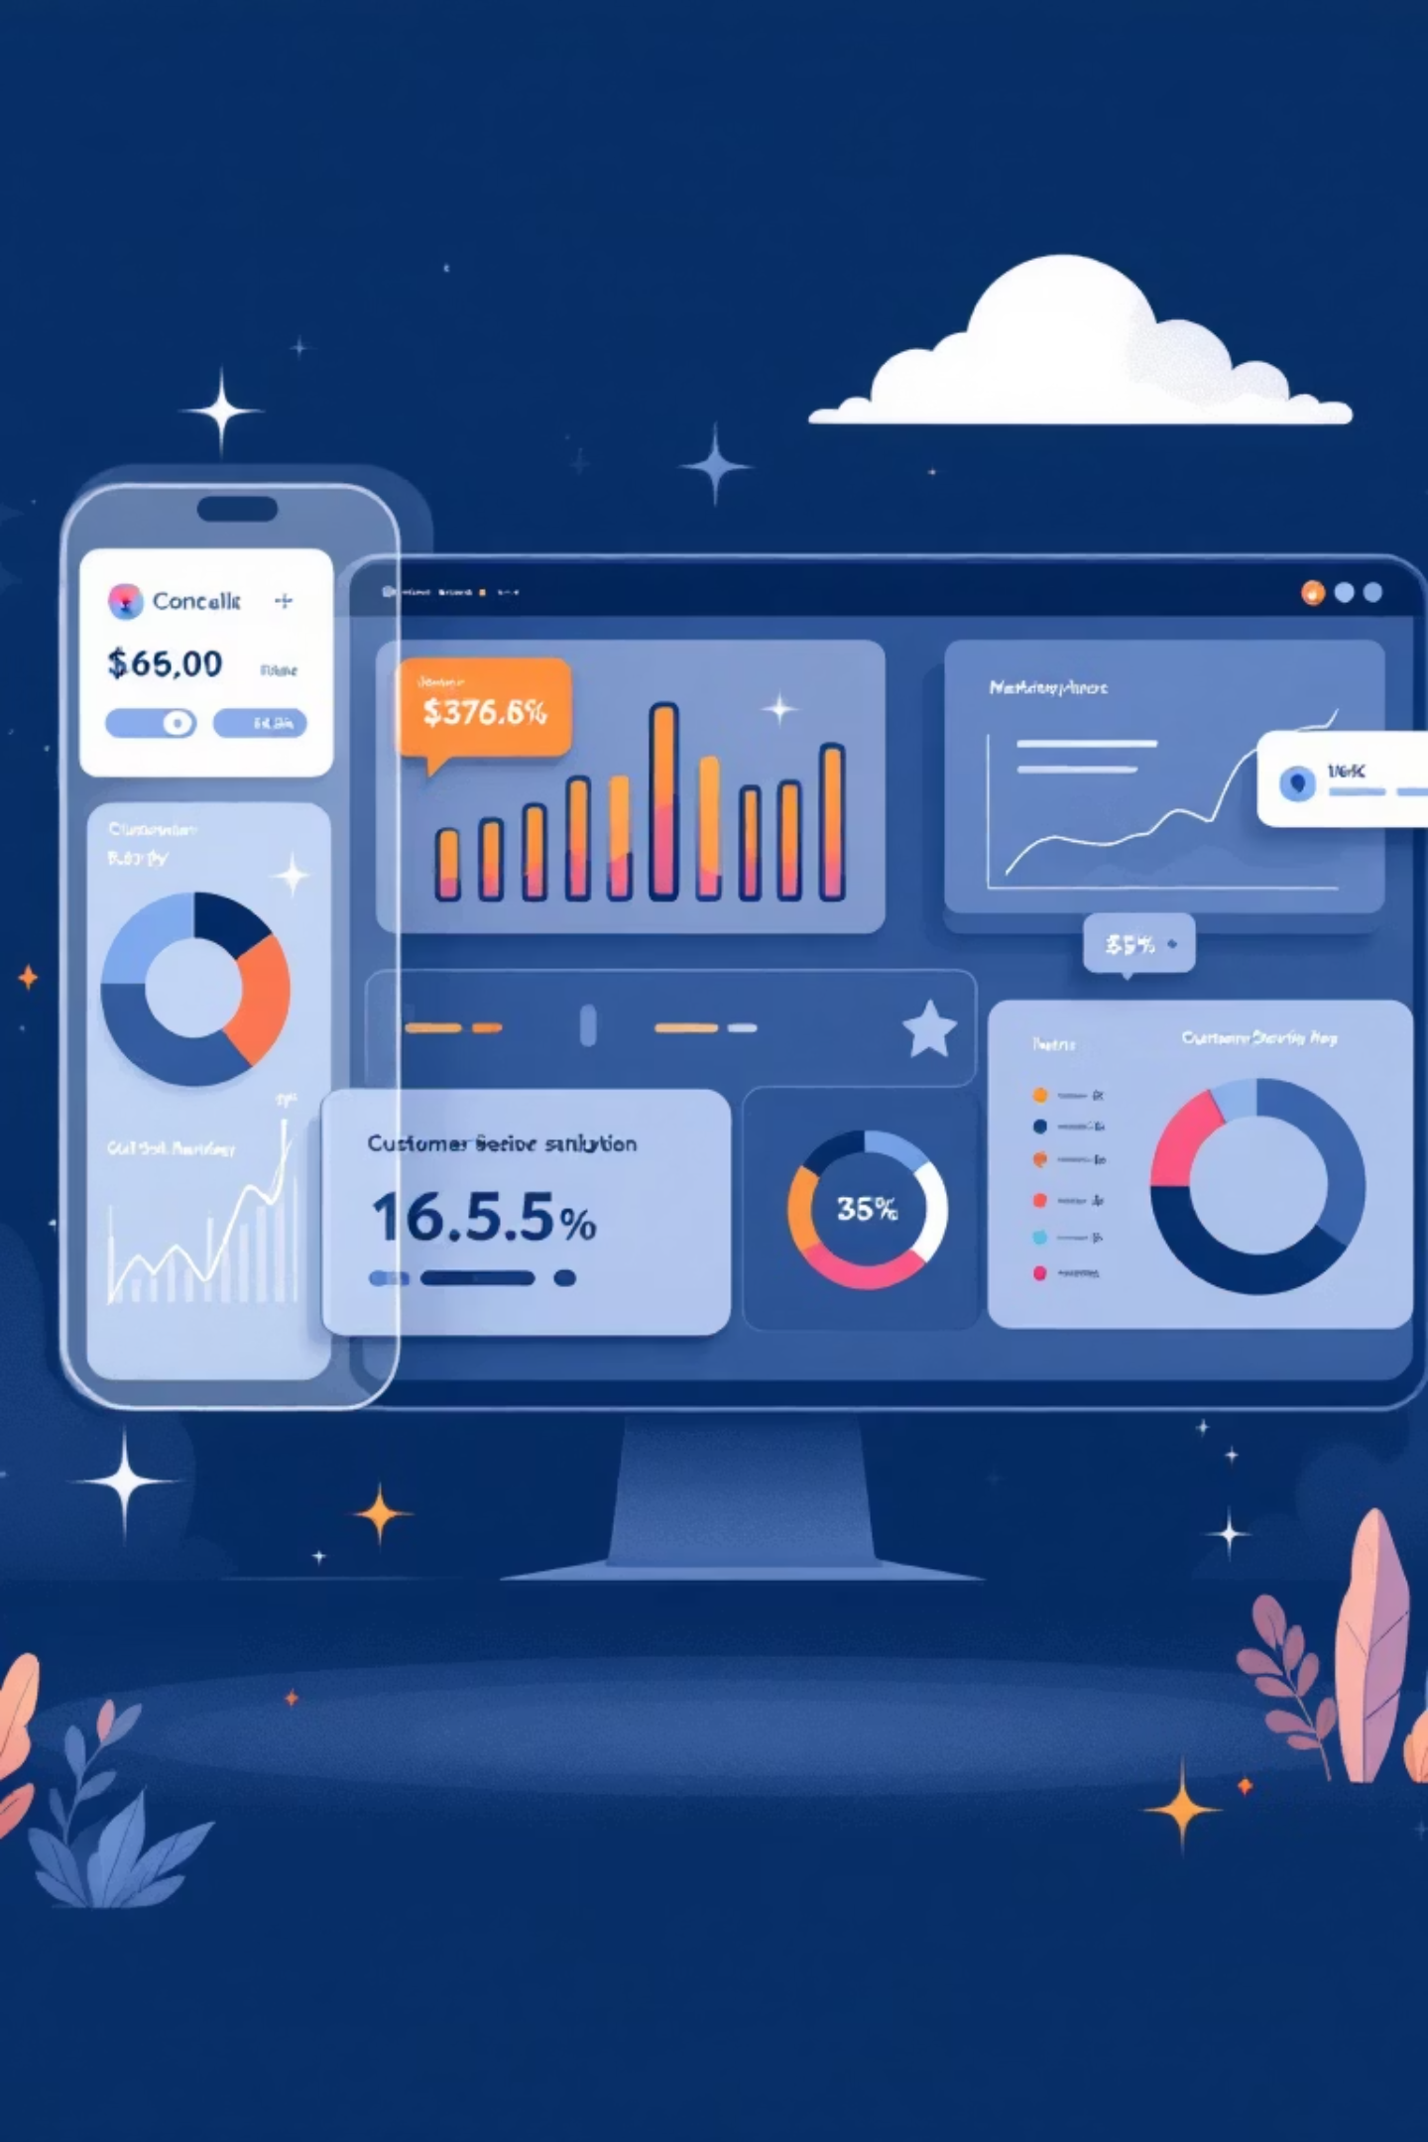




Behavior Beats Demographics
Spend Patterns
Purchase amount history
Recency
Time since last purchase
Frequency
Purchase repetition rate
Behavioral metrics explain campaign response better than demographics alone. Value-based segmentation enables clearer, more effective targeting decisions.
Key Takeaway: Behavior-driven targeting outperforms demographic-only targeting.

Slide 10

The Power of Targeted Marketing
Reduced Waste
Retained Impact
Focusing on high- and mid-value customers significantly reduces unnecessary campaign reach
Most revenue and response impact preserved despite narrower targeting
Improved ROI
Better returns without sacrificing business outcomes
Final Insight: Marketing effectiveness improves when campaigns are targeted, timely, and value-driven. Broad, untargeted campaigns increase cost with limited incremental benefit.

